Slide 1

Gun Violence in u.s.a.
2014 – 2021
Stevland Matthew

Slide 2
On average there are about 45,000-gun related injuries in the US. Resulting in either death or injury This data is Aggregated information of over three thousand incidents of gun violence within the United States from Jan 2014 through Dec 2021. sources used: https://www.gunviolencearchive.org/incident/{incident_id} According to https://worldpopulationreview.com/state-rankings/strictest-gun-laws-by-state The states with the most lenient gun laws are New Hampshire, South Carolina, Georgia, Louisiana, Maine, Texas, Montana, West Virginia, Alabama, North Dakota, Oklahoma, Arkansas, Alaska, Kansas, South Dakota, Arizona, Kentucky, Missouri, Idaho, Wyoming, and Mississippi.
Introduction

Slide 3

MOTIVATION
Use Python and Tableau ONLY for this project!
With the rise in gun violence throughout the country, curiosity struck me to analysis what states have the most gun violence as I just recently moved to GA from FL
My thoughts were that the mid-west states and most populated stated would be where we would see most of gun violence due to the less strict gun law and where more humans live more humans more problems
What months would have the most gun violence 2014-2021?
Which state in 2021 lead in gun violence deaths?
Which cities in Florida had the most total gun violence 2014-2021

Slide 4


ANALYSIS
Python
Imported cvs file into Python
Imported libraries pandas, numpy and seaborn
Checked for null values
Dropped [address] column
Changed data types
Object to string
Float to int64 due to decimals
Created export file after cleaning
Imported cvs text file
Created calculated field
Total killed and injured
Created 6 worksheets of analysis and 1 dashboard
Able to provide cleaner visualizations in Tableau vs Python
Data set info: 6 columns 3392 rows https://www.kaggle.com/datasets/konivat/us-gun-violence-archive-2014

Slide 5
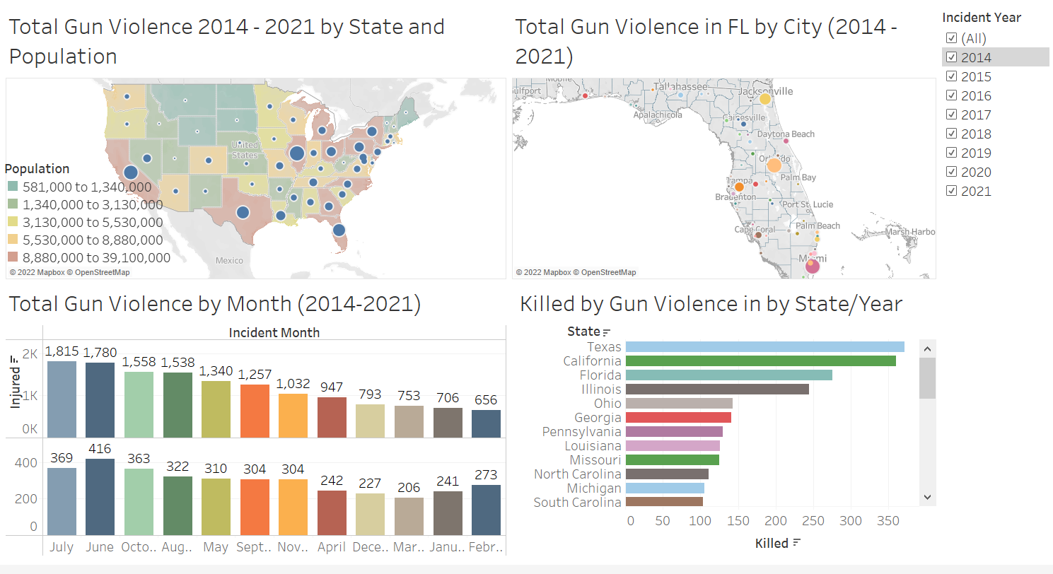

Slide 6
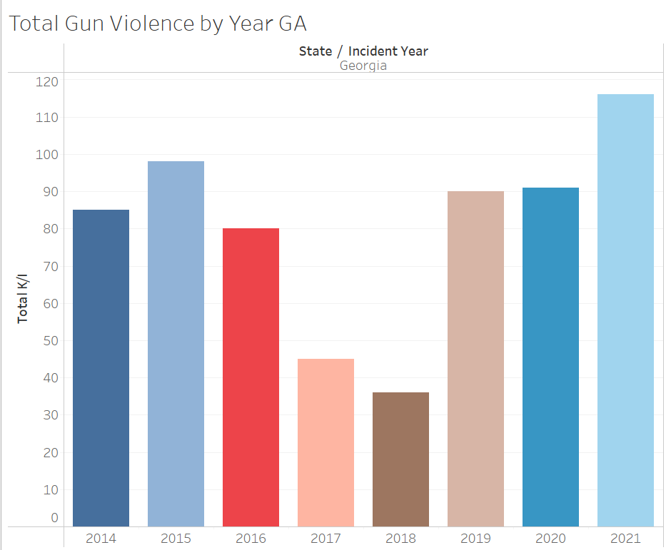

Slide 7
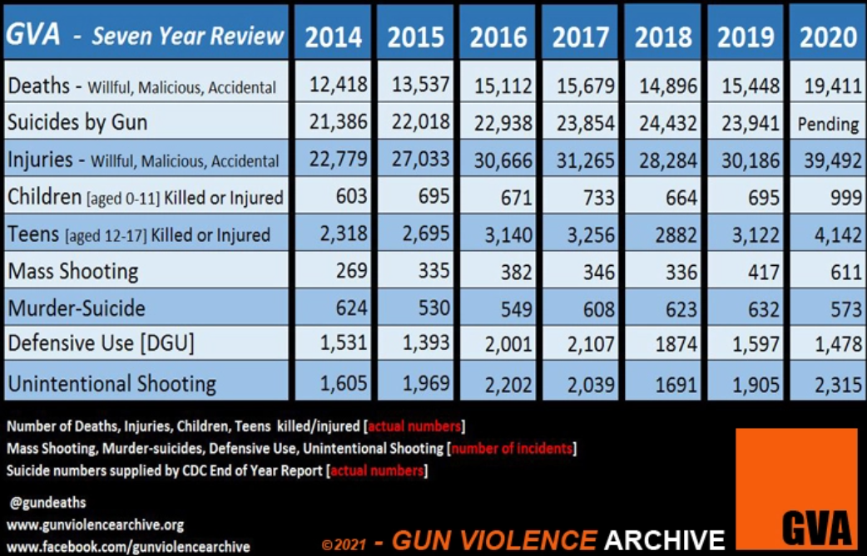

Slide 8

The higher populated states have the most gun violence
The state of Georgia does show and increase in gun violence since 2019 after a drop in 2018 DATA SHOWS THE SUMMER MONTHS ARE WHEN THE MOST GUN VIOLENCE OCCURS June and July top 2 months I am curious to see now with the new gun laws in ga if the gun violence will increase it is alarming to see gun violence on the rise. Will Stricter gun laws solve this issue? most importantly I learned new tools to analysis data. Python was a challenge but found it very useful on certain data sets. My Hope is that all hf employees in this class leave with greater knowledge of the tools we learned. Also take back this information to our departments as we continue improve our business processes.

